Slide 1
Unit 2- Lecture 19
Game playing algorithm
Algorithm MiniMax
Algorithm AphaBeta

Slide 2
Game playing algorithm
The basic procedure for game playing is then the following.
  Explore the tree up to a finite ply depth.
  Compute the evaluation function of the nodes on the frontier.
  Use the minimax backup rule to determine the value of the partial game tree, and the best move.
  Make the chosen move, wait for the opponent's move, and then again search for your best move.
If we could have searched the entire tree, the search would have to be done only once.
But constrained to search only a part of a tree, we do a series of searches, one every time the program has to make a move.
Every subsequent search starts two plies deeper than the previous one, and explores two more plies in the game tree.

Slide 3
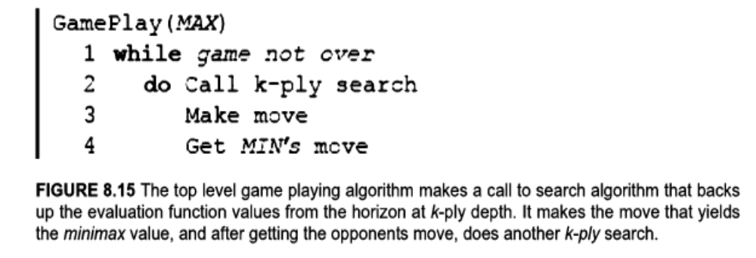

Slide 4
But, as shown in next slide figure, since it searches only below the chosen moves, it only looks at a fixed number of nodes at each level in the game tree.
The complexity of algorithm can be depicted by the area of the search tree, which is proportional to the number of nodes in the tree.
The figure below gives one an intuitive idea that the series of fixed ply searches explore only a small part of the entire game tree.
Assuming that each search looks at P nodes, the game playing program will look at a total of PN/2 nodes during the entire time, where N is the number of moves made by both sides.

Slide 5
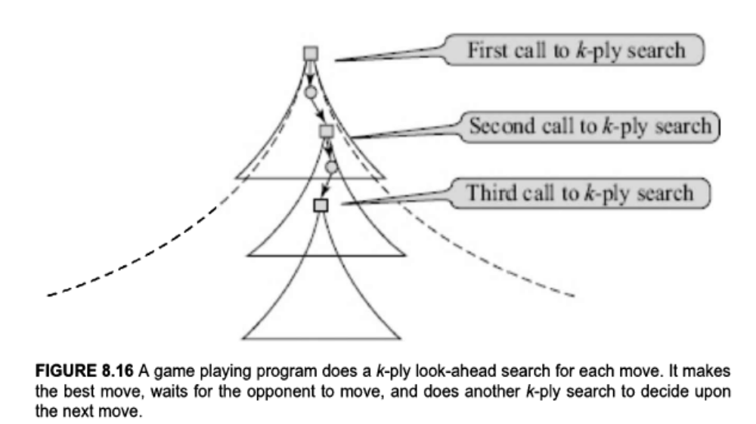
We now look at the basic algorithm for doing the fixed ply search.
The algorithm uses an evaluation function e(J) when considering the nodes at the frontier.

Slide 6
Algorithm Minimax
The algorithm Minimax searches the game tree till depth k in a depth-first manner from left to right.
It applies the minimax rule (last figure) to determine the value of the root node.
The algorithm in next figure is a recursive version adapted from Pearl, 1984.
The algorithm uses a test Terminal (node) to determine whether it is looking at a frontier node, and therefore should apply the evaluation function e(J) instead of making a recursive call.
A node is a terminal of a leaf node of the game, and will evaluate to one of {—Large, 0, +Large} or it is a node on the horizon, and in that case the evaluation function e(J) will be applied.
Not shown in the algorithm is the implementation of the test for terminal node.

Slide 7
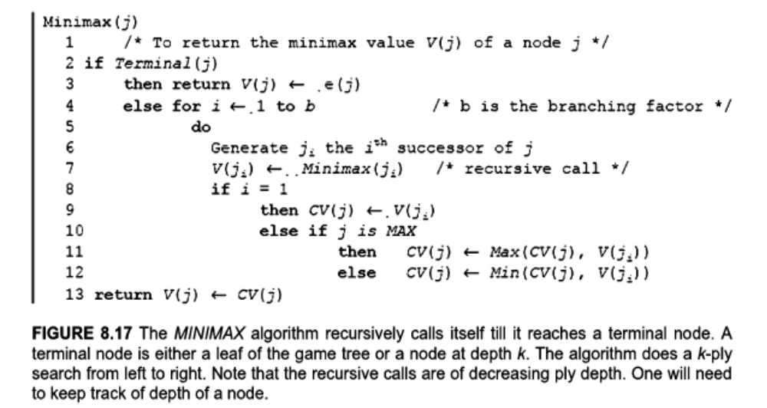

Slide 8
It will need incorporation of a depth parameter k, perhaps passed along with the node, decremented at each recursive call.
It will become zero when the node is on the horizon.
In the last slide algorithm, the minimax value is returned but not the best move that leads to that value.
Since the objective is to play the game, the next slide version returns the best move.
It calls the above Minimax algorithm for each successor of the root, and keeps track of the best move as well as the best board value.
Slide 10 depicts the tree searched by the algorithm Minimax and BestMove for a synthetic game tree.

Slide 9
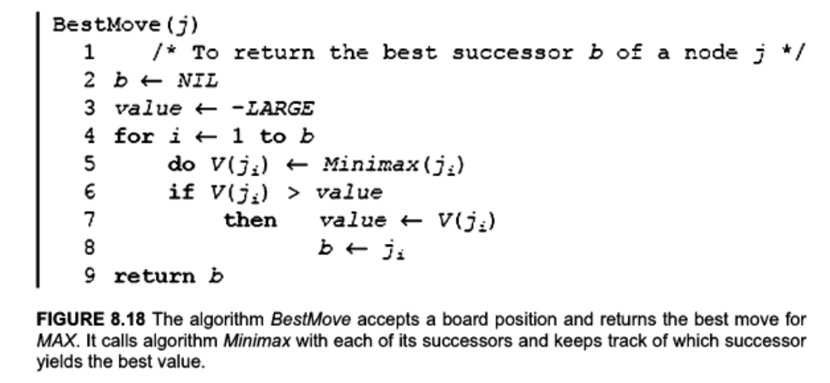

Slide 10
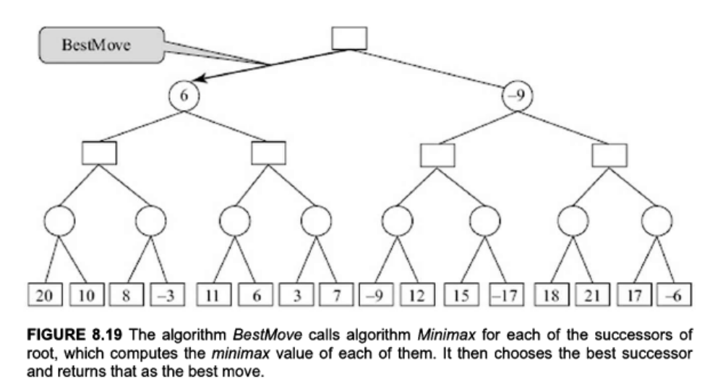

Slide 11
The tree is a binary tree, with two choices to each player at each level.
The values for the evaluation at the 4-ply level have been arbitrarily chosen.
The Minimax algorithm above is the one that is doing the search.
The BestMove algorithm is simply a modification to keep track of the best move found by Minimax.
The algorithm Minimax finds the best move after searching the entire tree k-ply deep.
There are, however, situations when it is not necessary to continue searching.
This happens when it is known that searching further does have any scope of improvement.

Slide 12
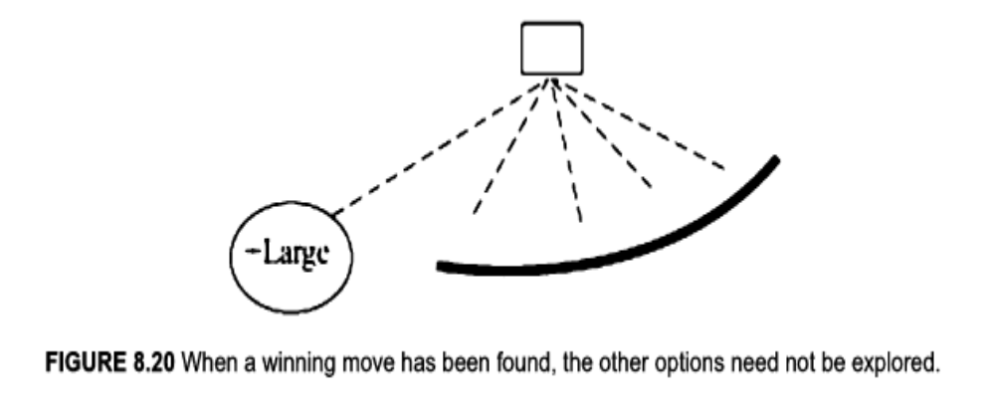
The simplest case is when a winning move has already been found, as shown in below figure.

Slide 13
Algorithm AlphaBeta
In the previous figure, MAX has found a successor that evaluates to +Large.
Since one cannot hope to improve upon, it does not make sense to search any further.
We say that the search tree has been pruned.
For pruning to happen, it is not necessary that a winning move has been found.
It can also happen that during exploration it becomes clear that a particular child of a node cannot offer to improve upon the value delivered by a sibling.
In that case, that node need not be explored further.
Let us view the game tree as a supply-chain process.

Slide 14
At the top level, MAX has a set of MIN suppliers, from which it will select the one with the maximum value.
Likewise, each MIN has MAX suppliers, from which the one with the lowest valued one will be selected.
This process continues down the tree.
As the search in algorithm Minimax continues from the left to right, each node on the search frontier has been partially evaluated as shown in next figure.
We will call the partially (or fully) known values of MAX nodes as a values.
These values are lower bounds on the value of the MAX node.
This is because that the MAX node will only accept higher values from the unevaluated successors.

Slide 15
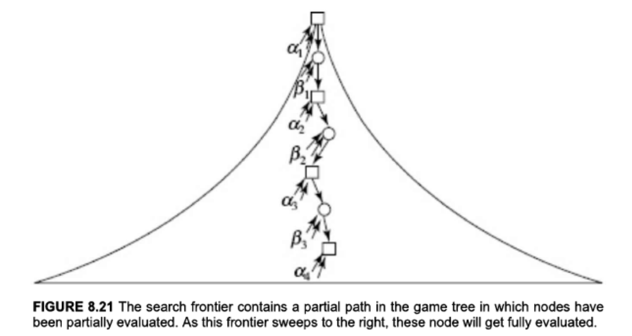

Slide 16
MAX nodes are also known as Alpha nodes.
Likewise, MIN nodes are also called Beta nodes and store b values, which are upper bounds on values of the concerned MIN nodes.
Remember that the a and b values are values that are already available to the respective nodes.
They are not going to be interested in any successors that offer something inferior.
Not only that, they are not going to be interested in any descendant that does not offer a better value.
The next example is from the Noughts and Crosses game.

Slide 17
We assume a 2-ply search, in which the following evaluation function is used,
e(J) = (numbers of rows, columns and diagonals available to MAX) — (number of rows, columns and diagonals available to MIN)
We look at the progress of the search to understand the need to prune search, shown in figure in slide 18.
The algorithm starts with MIN child A by placing a cross in a corner.
The MIN node A looks at all children and evaluates to a value -1.
Note that while there are seven successors of A, only the five distinct ones are shown in the figure.

Slide 18
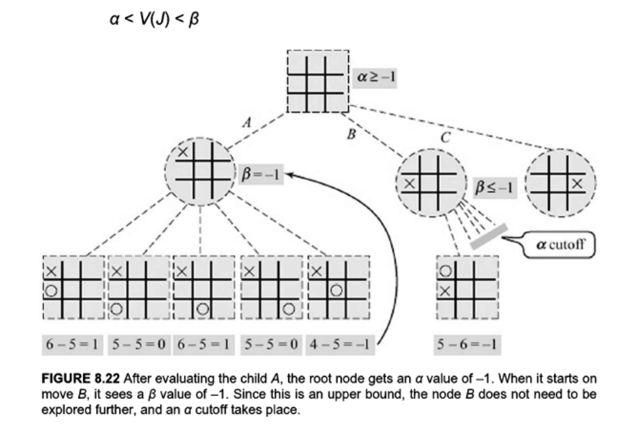

Slide 19
Now the root has a = —1, which means that it will not go lower than —1.
In the figure, this is expressed by the inequality a >=—1.
It then turns to MIN child B.
The first successor of B sends back a value —1, which becomes an upper bound on the value of B.
Since this is an upper bound and the root is already getting a value —1, the root is not going to be influenced by B, and the rest of the tree below B can be pruned away.
Note that even with k-ply search, where k is larger, the same pruning will happen as long as the backed-up values are as shown.
It is also important to note that a node can be pruned only after it has been partially evaluated.

Slide 20
We call the pruning shown in the above figure an α cutoff.
An α cutoff occurs below a β node, when it is constrained to evaluate to a lower (or equal) value than the α value above it.
Correspondingly, when an α node has a lower bound (a value) that is higher than the β value of an ancestor than the rest of the tree below, it is pruned.
This is known as a β cutoff.
In fact, this conflict between the bounds of two nodes need not be between a parent and child only.
The Alpha node J in slide 15 (with value α₄) will influence the root, only if it is greater that all the a values in the (Alpha) ancestors, and smaller than all the β values in the (Beta) ancestors.

Slide 21
That is, the value V(J) of a node J must satisfy,
α < V(J) < β
where,
a = max { α1 , α2, α3, ...}, and
p = min { β1, β2, β3, …}
When we are about to solve for a node J, we can propagate these bounds to the algorithm from its ancestors, and terminate the search if these bounds are crossed.
Note that an Alpha node can only increase in value, and can only cross a β bound.
If it does then the search below the Alpha node is discontinued, and a β cutoff takes place.

Slide 22
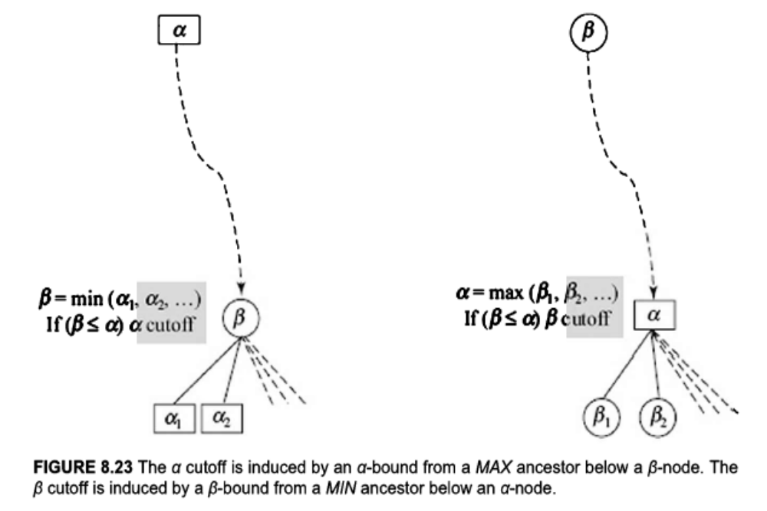
Likewise, a Beta node can only cross a lower bound α, and can be pruned using an α cutoff.
The two kinds of cutoffs are illustrated in below figure.

Slide 23
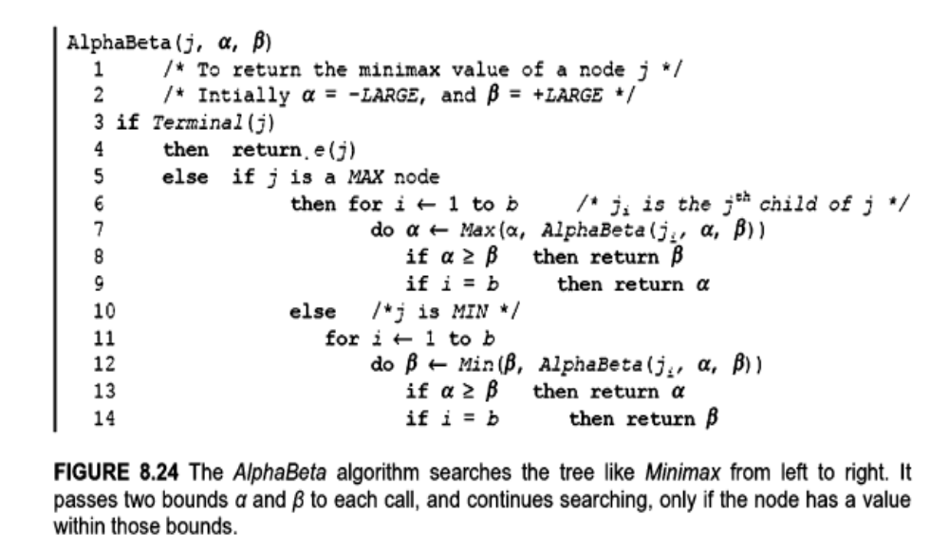
The resulting algorithm known as the AlphaBeta algorithm is given below

Slide 24
The AlphaBeta algorithm is called initially with bounds α = —Large, and β = +Large.
As search progresses, these bounds come closer, and eventually converge on the minimax value of the tree.
At any point, when it is recursively called with bounds α and β, it returns V(J) if the value lies between the two bounds.
Otherwise, it returns value β if J is an Alpha node, and returns α, if J is a Beta node.

Slide 25
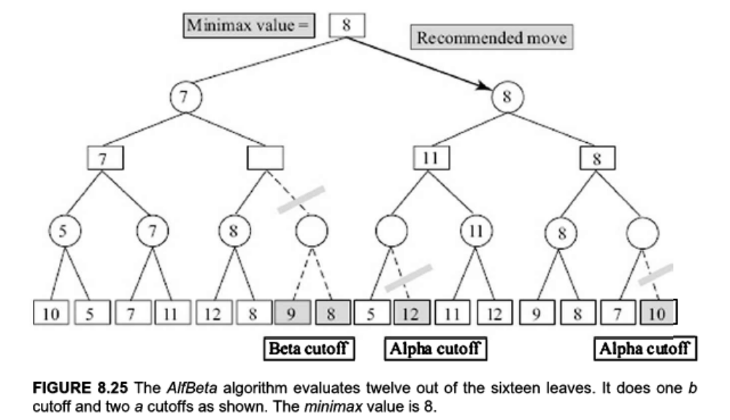
Example
The following figure shows the subtree in a 4-ply binary game.
The values of the evaluation function have been filled in randomly.

Slide 26
The reader is encouraged to verify that the minimax value of the game tree is indeed 8.
This is irrespective of the values that are in the pruned leaves, shown as shaded nodes.
Since the cutoffs are dictated by values of nodes seen earlier, the amount of pruning by AlphaBeta algorithm will depend upon the leaves seen earlier.
If the better moves for both sides are explored earlier then the window of α -bound and β -bound will shrink faster and more cutoffs will take place.
In particular, if the node whose value is backed up to the root, and which represents the best moves from both sides, is found earlier, the number of cutoffs will increase significantly.

Slide 27
In the above figure, one can observe that the minimax value comes from the right half of the tree.
Let us flip the tree about the root by reversing the order of the leaves and run the AlphaBeta procedure on the reversed tree.
The resulting cutoffs are shown in next figure.
As can be seen, the number of cutoffs in the same game tree, but with the order reversed, has gone up to eight, and only eight of the sixteen nodes are inspected.
It is evident that the performance of the AlphaBeta algorithm depends upon the order in which the moves are generated, and when the better moves are generated earlier, the cutoffs will be greater in number.

Slide 28
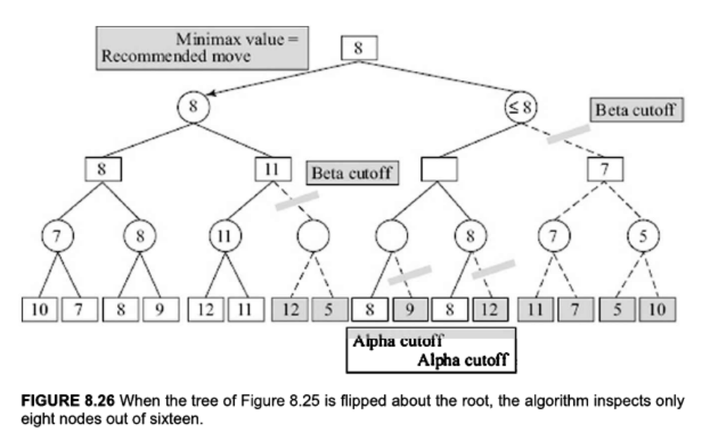

Slide 29
But how do we generate the better moves first? One way could be to somehow put in domain-specific heuristics to order the moves.
For example, in the Noughts and Crosses game, corner moves might be preferred over side moves.
Another, and a domain independent, way would be to use one instance of search to order the moves in the next instance of search.
Let us say MAX is to play in some board position X.
MAX calls the AlphaBeta algorithm and along with finding the best moves, also keeps track of the moves it explored at the third ply.
These are moves it will start searching with the next time it has to make a move.
MAX utilizes the current search to order the moves in preparation of the next one.

